Slide 1

Educational Game Water Conservation
Wanrong Xu
https://youtu.be/7tSCKe-H69Y

Slide 2

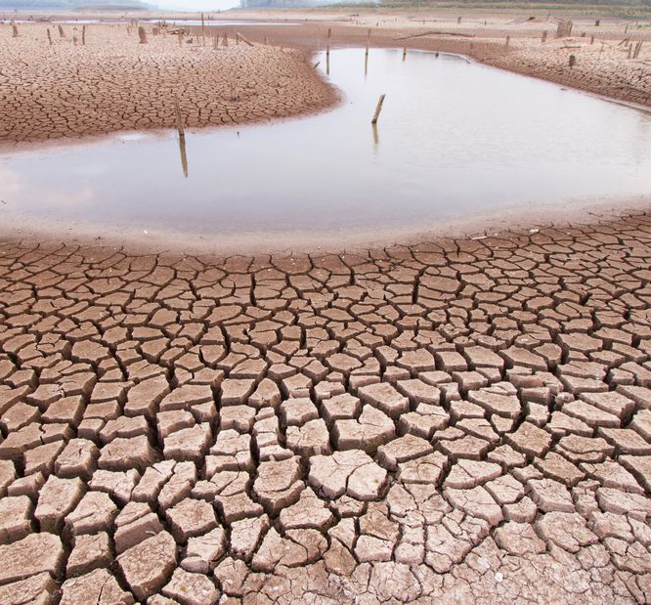
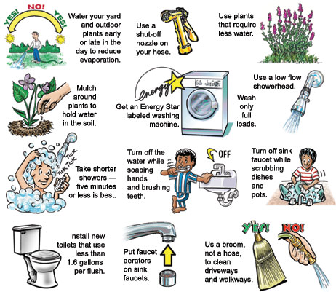
Background and Introduction
Water scarcity
The importance of water
Water conservation techniques
Water makes up about 70% of the human body, the brain contains more than 75% water.
Concentration, memory, reaction speed, and positive emotions can all be affected by dehydration.
With the unreasonable exploitation and utilization of water resources, many countries and regions have experienced water shortage problems of varying degrees. This is what we called Water scarcity.
Water conservation at home.
Agricultural Water Saving Practices.
Industrial Water Conservation.

Slide 3
Background and Introduction
video game
Serious game
A video game is an electronic game that is interactable on electronic device platforms with the main purpose of entertainment.
All video games are defined by three basic design patterns in order to provide players with a virtual playground: Rules, Play, and Culture.
Serious game is a type of video game, but this type of video game is not just for entertainment but for application.
Serious games are used in many different fields: Education, Military, and Medical/Healthcare.

Slide 4
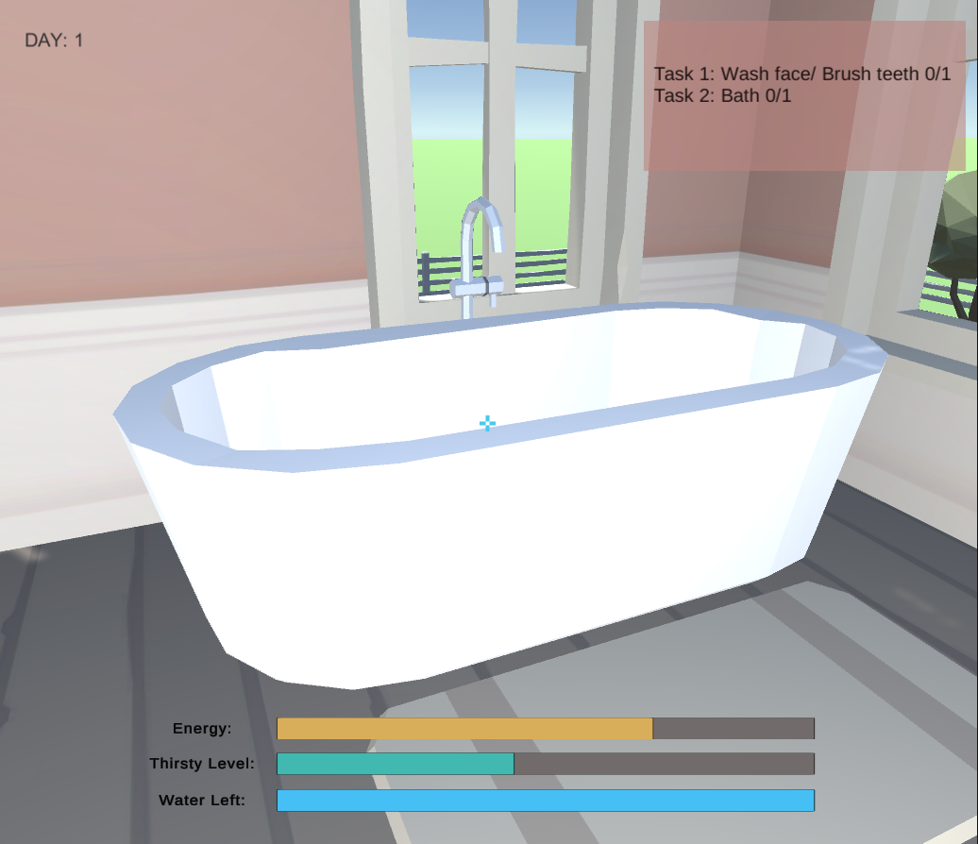
Implementation
Project Aim
To create an educational game for Water Conservation.
Game Design
UI
Functionality
Gameplay

Slide 5
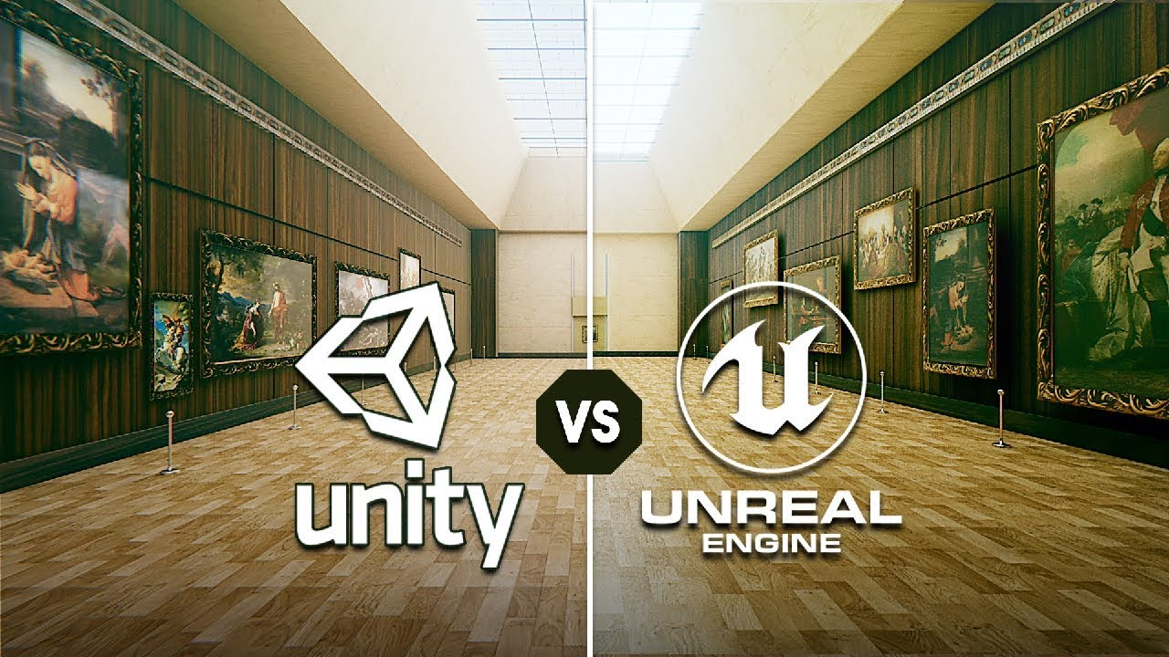
Implementation
Game Engine
A complete game engine consists of many different components, each component has its own specific function. Game engines have 5 main components: Rendering engine, Artificial Intelligence, Physics engine, Sound engine and Networking.
Mainstream Game Engines: Unity 3D and Unreal Engine
Unity vs Unreal
Unity: C#, JavaScript and Boo
Huge amount of tutorial videos online
Unreal: C++
Blueprint

Slide 6
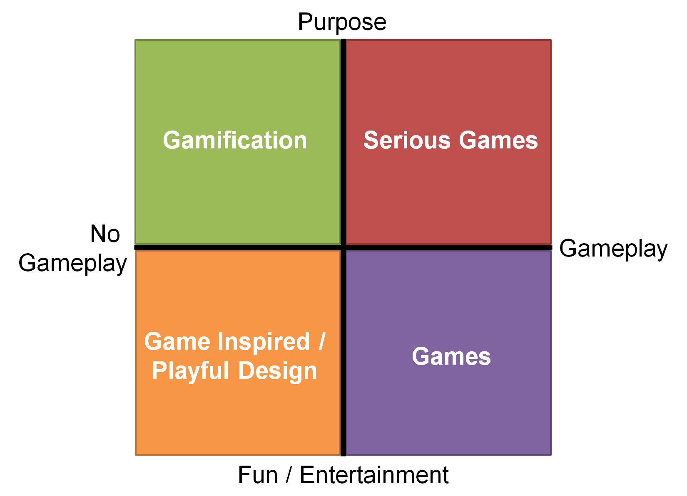
Challenges
Balancing the fun factor with educational value.
Not developing more than necessary.

Slide 7
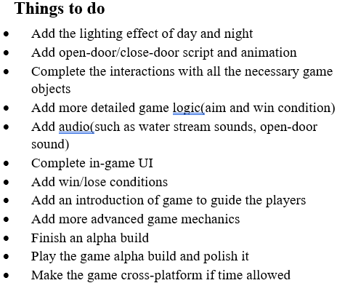
Evaluation and Analysis
plan Completeness
Event not complete:
Add an game introduction
Cross-platform

Slide 8
Evaluation and Analysis
Traditional education vs Educational game
Compared to traditional education, the educational game increases student motivation.
The vast majority of students prefer the Game-Based learning method to traditional teaching.
Educational games can foster creativity in students.

Slide 9
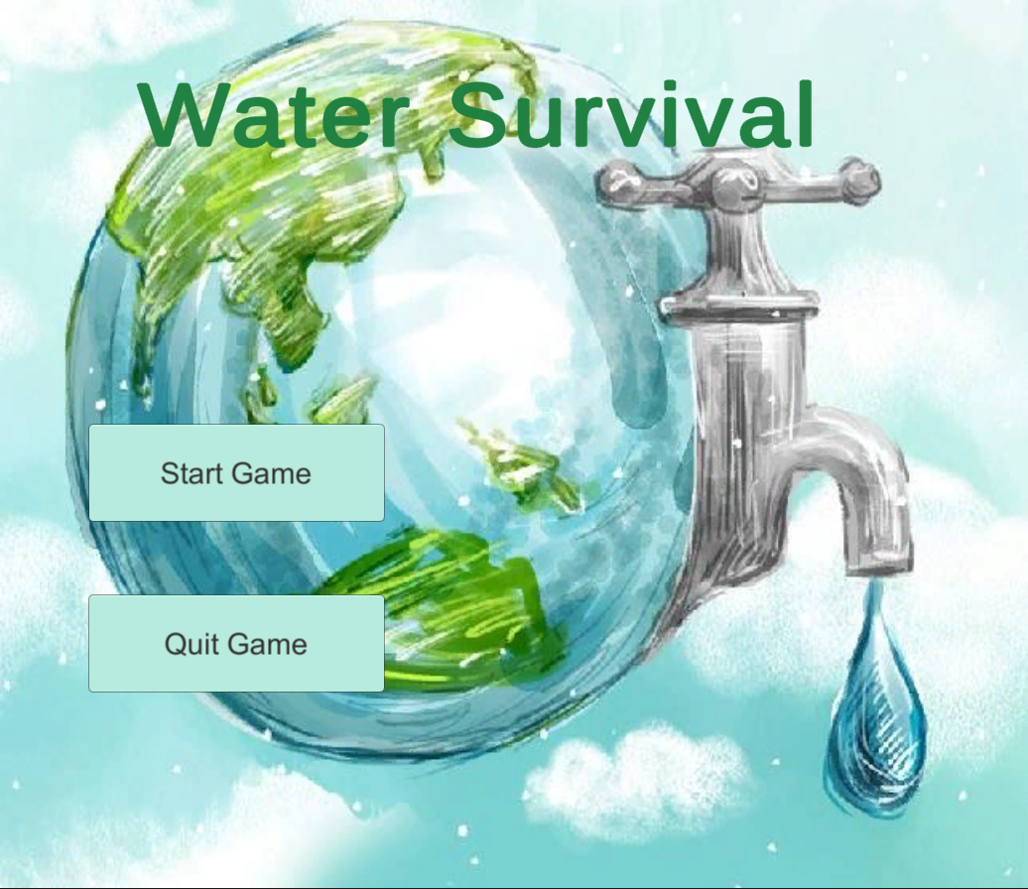
Conclusion
Using an educational video game to provide a proper education can have an enormous impact on water conservation practices. However, this can only be achieved through a proper design of the educational game, which help with their positive learning benefits towards water conservation.
Overall, I believe my project has gone well to a certain extent, though there still exist improvements.

Slide 10

Thank You
Wanrong Xu
C1030208@newcastle.ac.uk

